Slide 1

Cynthia Rubin Demand Generation Testing Plan Strategy/Examples/Results Interview with indeed.com

Slide 2

Campaign Status
Successful display advertising campaign with 24/7 Media from June – August 2011
Budget: $10K per month, total $30K for BBN and Retargeting; approx 1.5M impressions
277 leads generated (CT and view-based)
$108 CPL
$12 below target CPL of $120/lead

Slide 3
Next Steps
Email marketing campaigns using the BBN network; August - October 2011
Target audience: small business
US only
Any industry
Between 5-50 employees
Use “benefits” copy in line with successful banner ads and landing pages
10,000 emails once per month
Budget $2,500

Slide 4
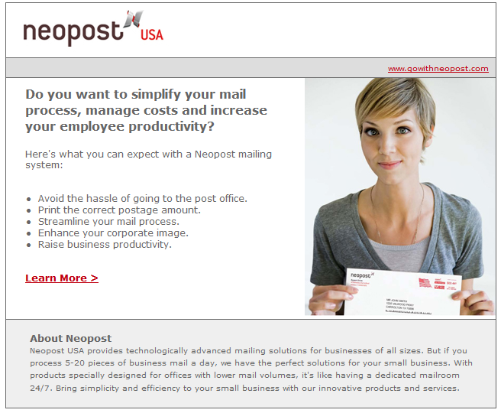
Results – 3 Month Average
High open rate
16.7%
Vendor indicated an avg of 8-10%
Low CTR
1.2%
Low # conversions
6 leads
Very high CPL
$416

Slide 5
Assumptions
Low CTR and conversions could indicate improvements could be made to:
Call to action
Imagery
Email copy
Promotion testing
Landing page

Slide 6
Next Steps
Objective: increase total # of leads to reach target CPL: $120
Create A/B Testing Plan
90/10 split
7 days between test blast and final blast
10,000 recipients per blast
6 months; November 2011 – April 2012
Budget: $15K

Slide 7
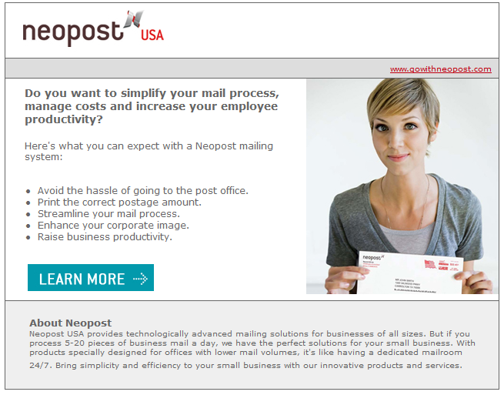
November
Call to action
Text vs. button
Date | Creative | Emails Sent | Open Rate | CTR | # of leads
11/8/2011 | Text CTA | 498 | 16.20% | 0.08% | 0
11/8/2011 | Button CTA | 494 | 16.09% | 1.01% | 0
11/15/2011 | Button CTA | 8,912 | 16.31% | 1.40% | 6

Slide 8
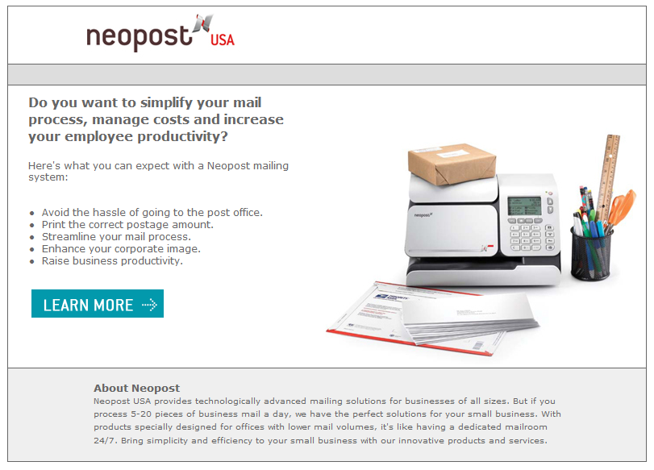
December
Imagery
Person vs. machine
Date | Creative | Emails Sent | Open Rate | CTR | # of leads
12/6/2011 | Person | 498 | 15.90% | 0.09% | 1
12/6/2011 | Machine | 499 | 16.01% | 0.08% | 0
12/13/2011 | Person | 8,944 | 16.12% | 1.10% | 6

Slide 9

January
Copy:
Benefits vs. promotion
Past 2 months of tests were very close with minimal differences; decided to do a full copy change from benefits to promotion leading to message appropriate landing pages.
Date | Creative | Emails Sent | Open Rate | CTR | # of leads
1/18/2012 | Benefits | 498 | 16.12% | 1.10% | 0
1/18/2012 | Promotion | 492 | 13.29% | 2.10% | 2
1/25/2012 | Promotion | 8,941 | 13.99% | 2.20% | 13

Slide 10

February
Headline
General vs promotion
Date | Creative | Emails Sent | Open Rate | CTR | # of leads
2/9/2012 | General | 492 | 12.99% | 2.19% | 1
2/9/2012 | Promotion | 499 | 13.12% | 2.90% | 2
2/16/2012 | Promotion | 8,921 | 13.99% | 2.98% | 15

Slide 11

March
Offer
Free vs save
Date | Creative | Emails Sent | Open Rate | CTR | # of leads
3/14/2012 | Free | 495 | 13.20% | 2.99% | 3
3/14/2012 | Save | 499 | 13.21% | 2.20% | 1
3/21/2012 | Free | 8,954 | 13.99% | 2.98% | 14

Slide 12
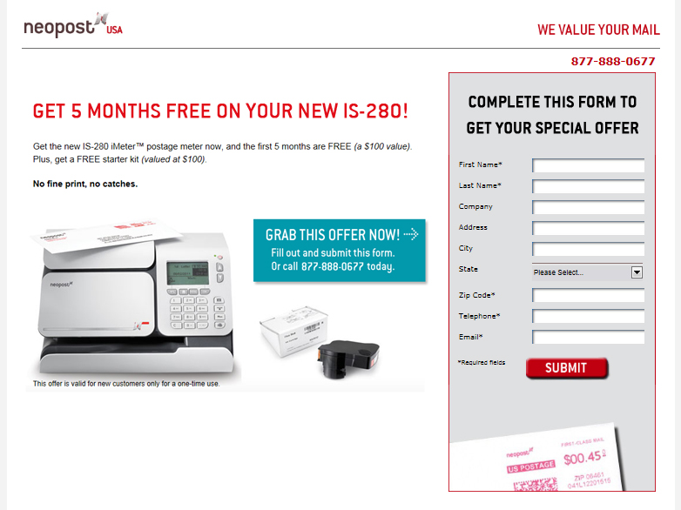
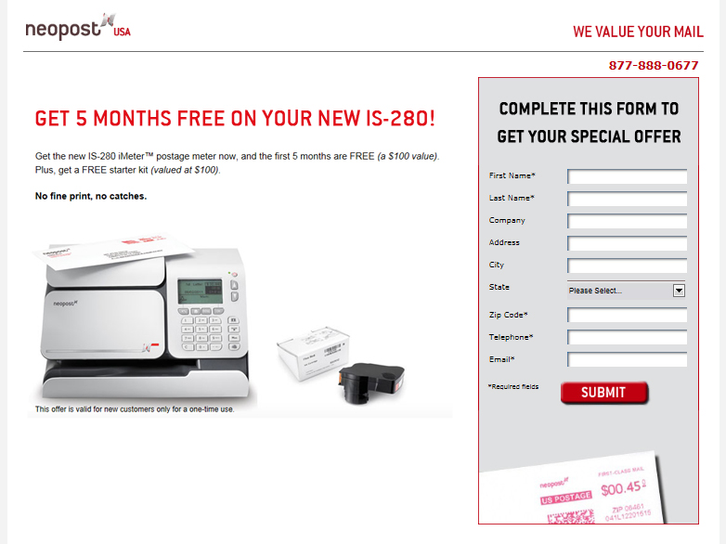
April
Landing page
Grab CTA vs. no CTA
Date | Creative | Emails Sent | Open Rate | CTR | # of leads
4/11/2012 | No CTA | 498 | 13.02% | 2.78% | 2
4/11/2012 | Grab CTA | 491 | 12.99% | 2.89% | 4
4/18/2012 | Grab CTA | 8,928 | 12.98% | 2.92% | 15

Slide 13
Conclusions
Minimal increase by using a button call-to-action vs. text.
Promotion emails were much more successful than the benefit driven emails for total number of leads.
“Free” messaging vs. the “Save” messaging generated more leads.
Landing page call-to-action generated double the leads of the page without the call-to-action.
The campaign generated a total of 85 leads; $175 CPL average for the entire campaign.
Biggest success was in the final three campaigns, averaging at 19 leads / $131 CPL; decrease of 218% CPL since the first email campaign.

Slide 14
Ideas for ads.indeed.com

Slide 15
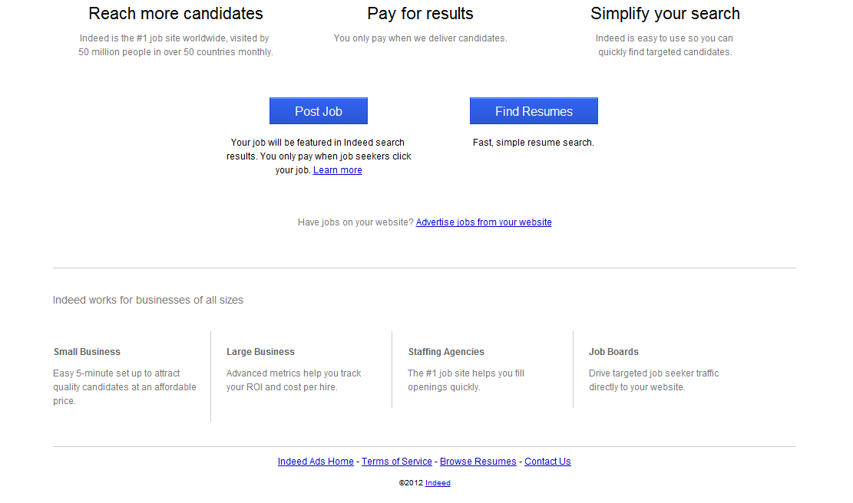
Testing Suggestions
Benefits:
Design variations: boxes, font color, move copy below buttons.
Copy variations: #1 global job site, Simple and cost-effective, Free social media ads;

Slide 16
Testing Suggestions
Buttons:
Design variations: larger size, different color, add a third button for the ‘Advertise’ option, remove text underneath box and make as part of the CTA
Copy variations: Add more ‘urgent’ call to action copy: Post a job now; Find the right candidate today; Advertise jobs directly on your website

Slide 17
Testing Suggestions
Business segments:
Make segments clickable to content pages that address them directly.
Move segments to the top of this page.
Change text color so it doesn’t get lost on the page (within brand standards).

